Slide 1
PerfTest: Setup – HTTP Server
Yoonki Song
Last Updated: Sep. 6, 2009

Slide 2
IBM HTTP Server v6.1
Installation and Configuration on the Server side

Slide 3
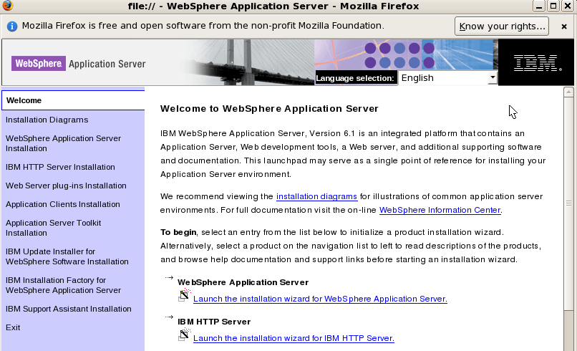
Installation
Launch the installation wizard for IBM HTTP Server

Slide 4
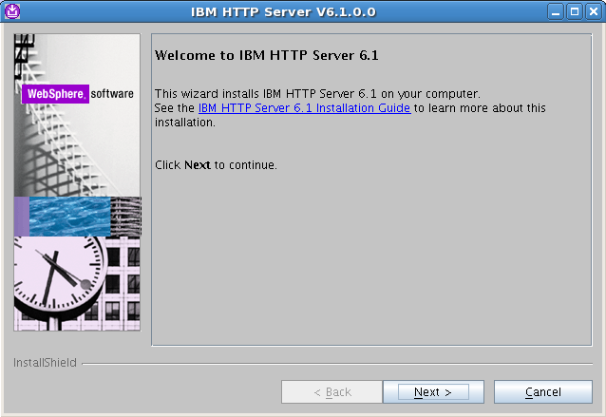
Installation

Slide 5
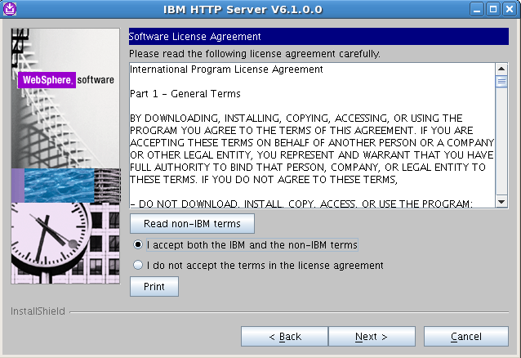
Installation (Cont’d)

Slide 6
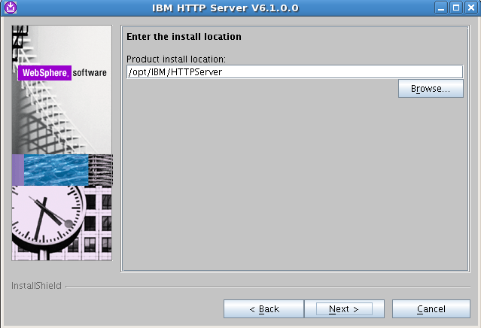
Installation (Cont’d)

Slide 7
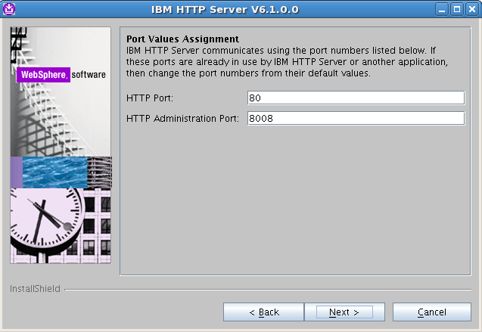
Installation (Cont’d)

Slide 8
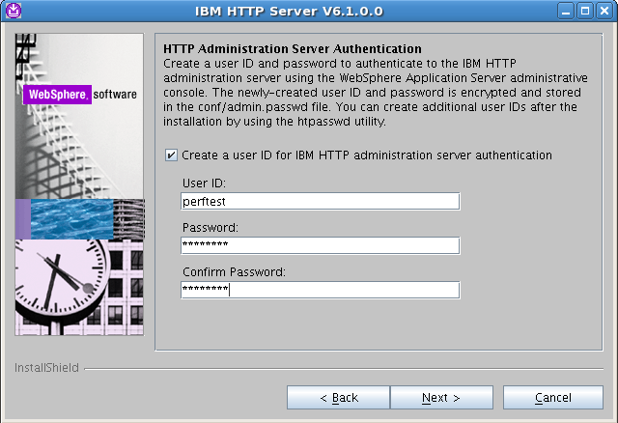
Installation (Cont’d)
perftest
perftest
perftest

Slide 9
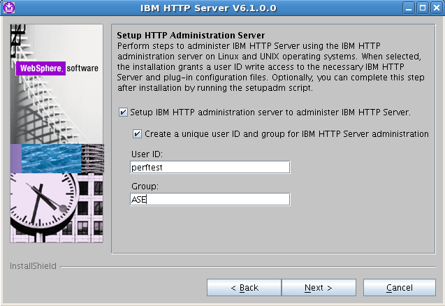
Installation (Cont’d)
perftest
ASE

Slide 10
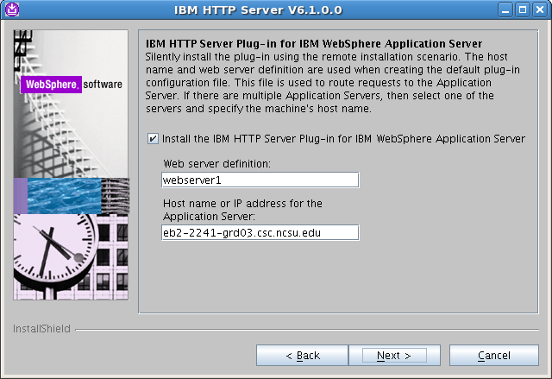
Installation (Cont’d)
webserver1
eb2-2241-grd03.csc.ncsu.edu

Slide 11
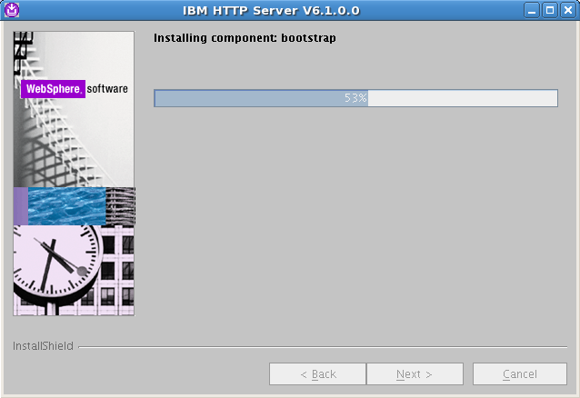
Installation (Cont’d)

Slide 12
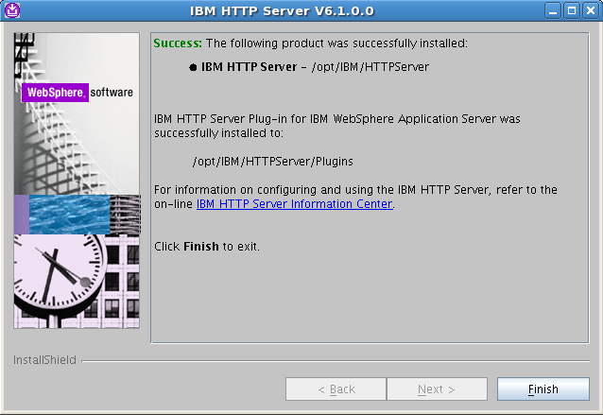
Installation (Cont’d)

Slide 13
IBM HTTP server commands
Start the IBM HTTP server
/opt/IBM/HTTPServer/bin/apachectl start
Stop the IBM HTTP server
/opt/IBM/HTTPServer/bin/apachectl stop
Start the IBM HTTP admin control service
/opt/IBM/HTTPServer/bin/adminctl start
Stop the IBM HTTP server admin control service
/opt/IBM/HTTPServer/bin/adminctl start

Slide 14
Uninstallation
/opt/IBM/HTTPServer/uninstall/uninstall

Slide 15
Web Server Plug-in
Installation and Configuration on the Server side

Slide 16
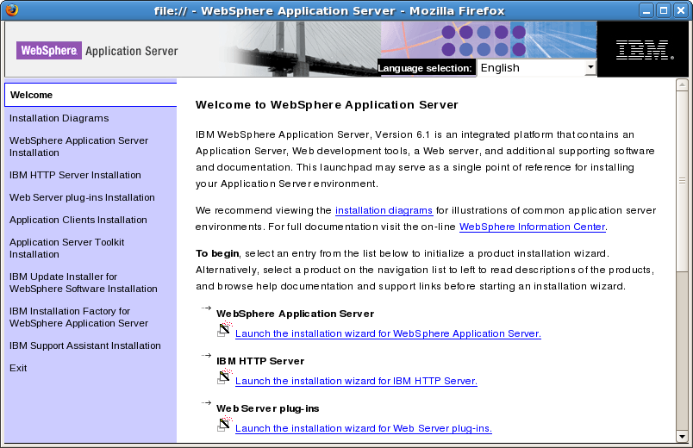
Installation

Slide 17
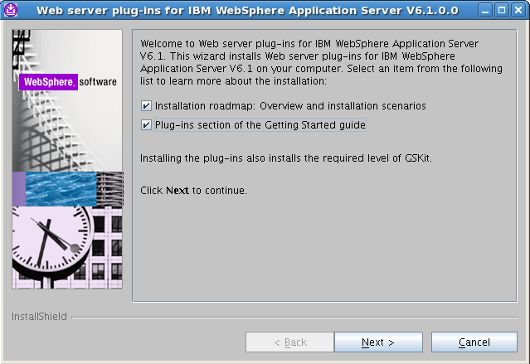
Installation (Cont’d)

Slide 18
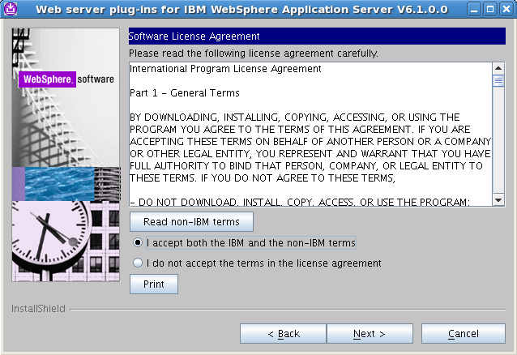
Installation (Cont’d)

Slide 19
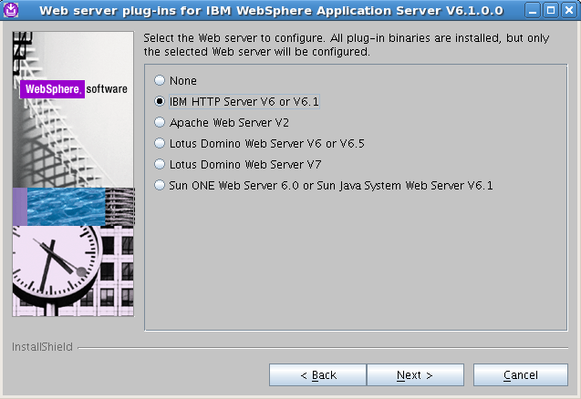
Installation (Cont’d)

Slide 20
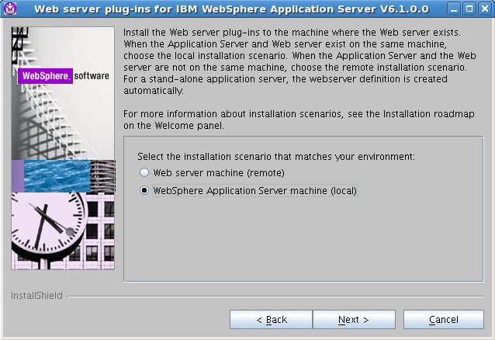
Installation (Cont’d)

Slide 21
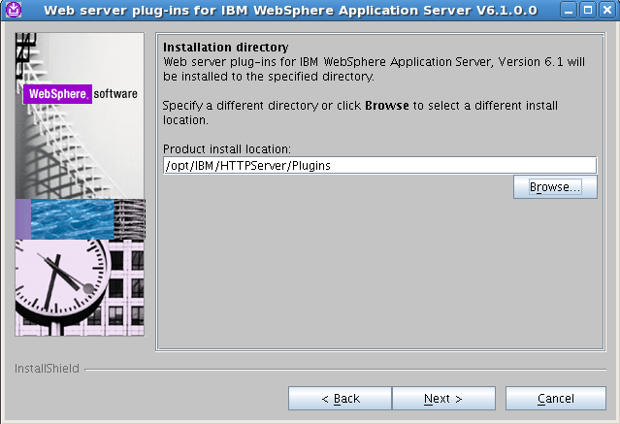
Installation (Cont’d)

Slide 22
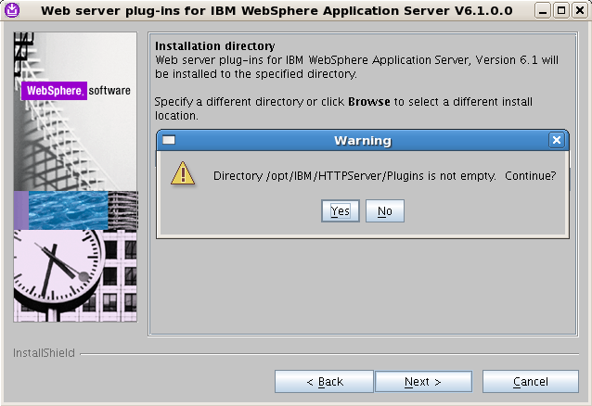
Installation (Cont’d)

Slide 23
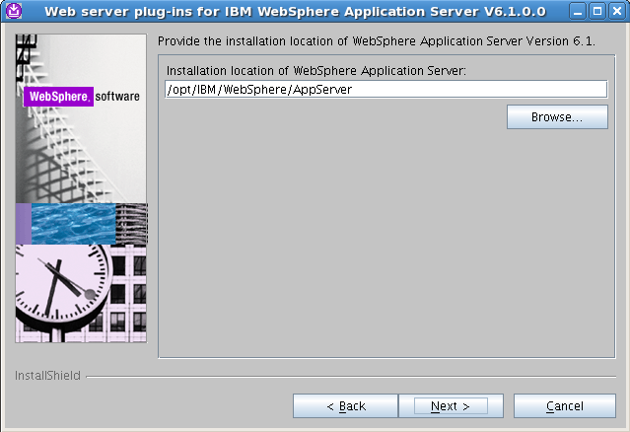
Installation (Cont’d)

Slide 24
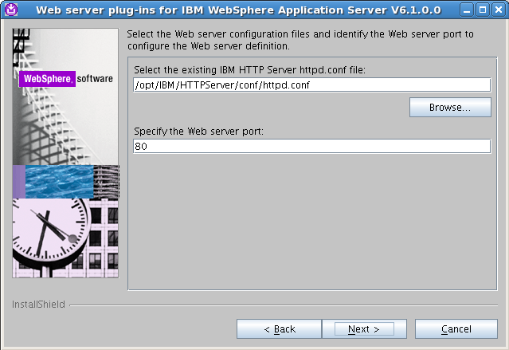
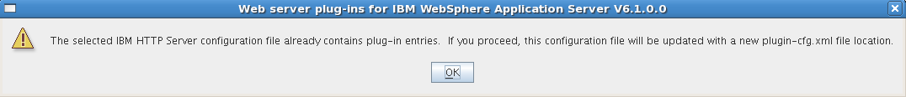
Installation (Cont’d)

Slide 25
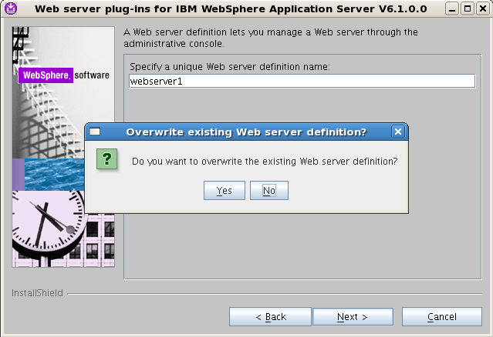
Installation (Cont’d)

Slide 26
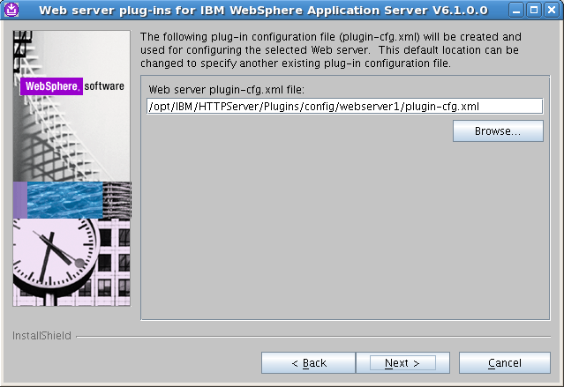
Installation (Cont’d)

Slide 27
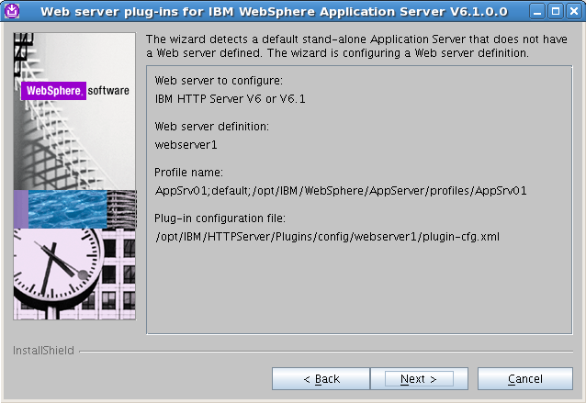
Installation (Cont’d)

Slide 28
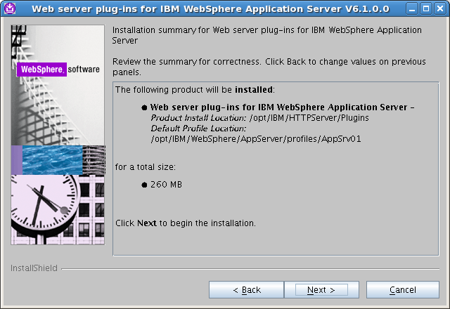
Installation (Cont’d)

Slide 29
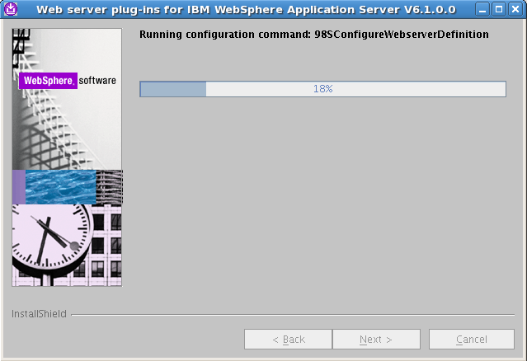
Installation (Cont’d)

Slide 30
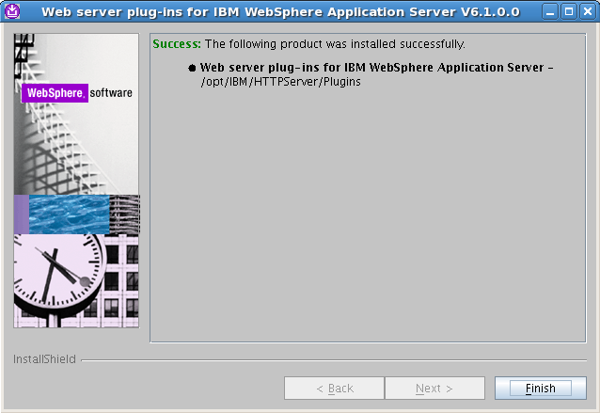
Installation (Cont’d)

